Slide 1
From Transactions to Enterprises
Nat Warmington
February 2020
Project 13

Slide 2
ICE in NZ – P13 Community of Practice
Seeks to foster a New Zealand community group of Clients and key industry members.
A space to discuss international and local examples of best-practice in the transition towards enterprise models of delivery.
Constrain an extensive subject matter into key focus areas we believe to be applicable to our unique environment.
Notes:
Project 13 was launched in 2018 by the Institution of Civil Engineers and the UK’s Infrastructure Client Group. They collectively aim to firmly establish P13 as a recognised industry approach in the development and delivery of infrastructure.
Project 13 has reached the shores of Australasia, with Sydney Water using the guidelines to develop their new Partnering for Success programme.
New Zealand organisations are adopting some of the key P13 principles, with the Piritahi alliance undertaking Land Development design/construction on behalf of Kāinga Ora, and Watercare's recently announced 40:20:20 sustainability vision and Enterprise Model.
The NZ Transport Agency has also set out their 2019 Infrastructure Procurement Strategy with broad spectrum of capital project contract types at its heart – from traditional lump sums to full Project Alliances.

Slide 3
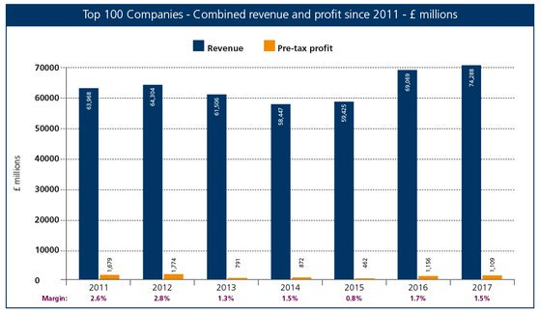
Why we need a new approach
Productivity
Unsustainable Industry
Source: Construction Leadership Council, “The Farmer Review – Modernise or Die” By M. Farmer 2016
Source: McKinsey&Company, “The construction productivity imperative” By S Changali, A Mohammad and M van Nieuwland, July 2015
Digital Transformation
Notes:
The UK’s working group identified productivity as a key concern. Worldwide, Construction’s productivity growth relative to other sectors is a long term negative trend.
Increasingly unsustainable business models in our industry have created a narrow focus on margin, and simultaneously shown a lack of investment in future skills and capability.
Digital Transformation (DT) - a theme which has pervaded all aspect of business in modern times. DT integrates information, processes and organisations. The Construction industry’s historic approach creates silos, interfaces and hand offs - and has the potential to be a real blocker to the adoption of technology. We need an approach that is more holistic and agile, one that facilitates the adoption of digital technologies.

Slide 4
What is Project 13?
An industry-led movement to improve the way high performance infrastructure is delivered.
Moving from transactional business models to collaborative business models.
Being adopted on some of the UK’s largest projects and internationally, bringing together skills and technologies in a collaborative environment
Building a sustainable future for the construction industry, creating a more highly skilled workforce and creating infrastructure that represents better value for all.
Notes:
The Project 13 initiative seeks to address the need for:
Different way of engaging
Different approach to procurement
Models that create integrated delivery teams
The initiative has a remit which seeks to take the conversation towards:
A focus on the whole supply chain
Providing opportunity for future investment
The concepts were leveraged off studies of six infrastructure projects led by University College London, and refined through consultations with infrastructure and construction companies.
It is the first step in the journey towards a different approach.

Slide 5
From transactions to enterprises
Notes:
Two contrasting diagrams – Firstly, Traditional approach:
Cascade delivery of scope
Individual transactions along the chain
Linear relationships defined by a contract and scope based procurement
Client contractor roles and behaviours
Moving to an Enterprise approach:
Delivering customer outcomes
bringing together the right skills and technologies to deliver this outcomes
Integrated delivery teams
longer term relationships
We are here because we believe an Enterprise Model can boost reliability and productivity in delivery, improve outcomes for users and customers – and support a more sustainable, innovative, industry.
The diagram explains what the new roles and responsibilities would be in the new model.
We have the Owner, who manages and operates the assets.
The Integrator who manages and coordinates relationships and manages the production system.
Suppliers / Advisors who have direct relationship with the Owner, or through the Integrator, but in either case are an integrated part of the enterprise.

Slide 6
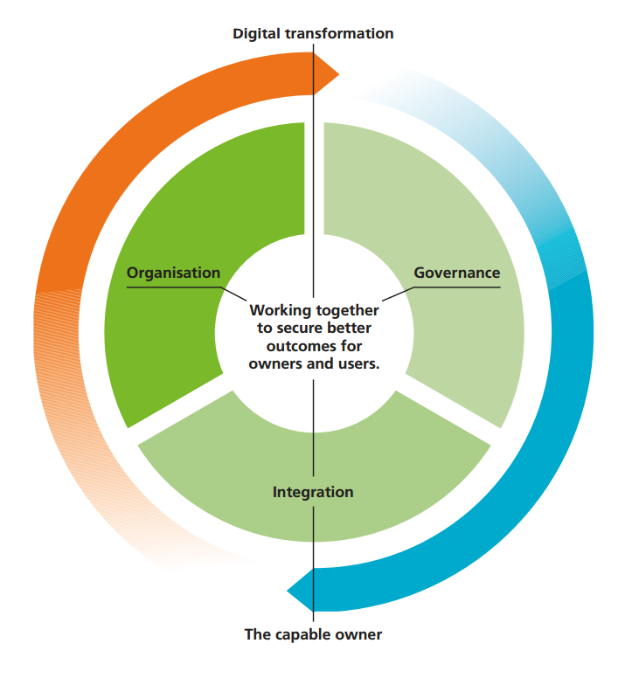
Core Principles
Capable owner
Governance
Organisation
Integration
Digital transformation
Notes:
Organisation, Governance and Integration are essential to securing better outcomes.
Capable owners are enablers that over time set the pace of change.
Capable Owner - develops an Enterprises built on long term b2b relationships. Set up to deliver:
- Clearly articulated customer outcomes
- Long term asset performance
Governance
Value is defined at outcome level (through baselines, benchmarks or affordability)
The Enterprise is rewarded for outcome performance
Risk allocation is aligned with capability - and where possible jointly owned
Commercial arrangements provide the potential for sustainable returns
There are clear incentives and opportunities for investment
Organisation
A single Enterprise organisation aligned with the outcomes to be delivered
Integrates the required capability in high performing, collaborative teams
Supplier capability engaged early in developing solutions
Integration
Supply systems organisationally and commercially aligned with the outcomes to be delivered
Has an integration capability that translates effective solutions into platforms and production systems
A common and committed approach to health, safety and wellbeing
Digital Transformation
Enterprise effectively integrates engineering and digital technology to deliver intelligent solutions

Slide 7
A shift in our thinking
From Growth | To Maturity
Focus on asset creation | Focus on asset management and operation
Focus on cost of initial build | Focus on long term performance
Outputs for Clients | Outcomes for the ultimate customers
Traditional constructed solutions | Innovative integrated digital/physical solutions
Fragmented, siloed organisations | Integrated enterprise team
Limited reward for developing skills | Incentivised to improve skills and staff productivity
Purchase scope | Reward outcomes + performance
Short term transactional relationships | Long term sustainable enterprises
Transfer risk | Incentives joint performance
Customer focus
Integrated
Sustainable Industry
Notes:
This highlights some of the shifts in approach and thinking required to make the transition to adopting the Project 13 Principles.
3 key areas to note:
A shift from scope and building stuff to a focus on customer outcomes and to delivering performance as experienced by the user. Project 13 creates alignment between owners (also customers) and all parts of the Enterprise through this focus on outcomes as the starting point for engagement.
Move towards an integrated Enterprise team, providing greater: continuity of thought across programmes, collective ownership in solving problems, exposure to down- and up-stream decision making.
A shift toward a more sustainable model. Move away from “reward for doing work (turnover or hours)” to “reward for delivering outcomes for greater value”. All key parts of enterprise, including owner, jointly incentivised to deliver customer outcomes

Slide 8
Three commercial principles
Alignment – commercial relationships should be aligned with achieving the owner’s outcomes.
Rewards – the parties rewards should be based on the value they add in achieving the outcomes.
Risks – risks should be limited to those that the parties can manage. Owner’s risks are not passed to the supply chain.
Three success factors
Engagement - the enterprise should be engaged as early as possible in the creation of the asset.
Scale - the enterprise yields greatest benefits when applied across complete portfolios.
Duration - the enterprise will improve performance over time. The longer it works the better it will get.
Notes:
This slide highlights the key commercial principals critical to generating the right commercial environment for the enterprise model.
Alignment – where commercial performance measures are aligned to delivery of outcomes to the customer/end user.
Reward – where reward mechanisms in the enterprise structure are based on value added in exceeding the outcomes, not competed lowest cost for a component.
Risk – where risks that the infrastructure Owner or Investor are accountable for are not transferred to the supply chain.
Three success factors:
Engagement – where the enterprise comes together at a much earlier stage in the asset enhancement/creation lifecycle.
Scale – where the enterprise model yields the greatest benefits when applied across asset systems/portfolios.
Time – where the relationships between organisations last over a longer time period.
What an Enterprise model can achieve is to bring together all parties with incentives that are aligned to the outcome for the ultimate customer – the end-user of our infrastructure.
In this way, we hope that Project 13’s aim of creating a step-change that will deliver better outcomes across the board can be realised. It promotes a new vision for infrastructure value: one that is longer term, outcomes based and extends to non-monetary benefits.
To achieve this vision for value, organisations must focus on the levels of maturity they first need to reach.

Slide 9
Three stages of maturity
Simple collaboration
Integrated
functions and relationships
High performing enterprise
Notes:
Project 13’s radical new industry-wide change programme is embodied by our new vision for infrastructure value: one that is longer term, outcomes based and extends to non-monetary benefits.
To achieve this vision for value, organisations must focus on the levels of maturity they first need to reach.
This slide demonstrates the 3 stages of maturity to organisations becoming High Performing Enterprises – and as collaborations between organisations mature there is less reliance on contracts. Likewise organisations become more effective at managing their combined resources to achieve required outcomes.
But how do we define what is simple collaboration and what is a high performing enterprise?
The self assessment Maturity Matrix can be used to identify the current status of a system and where there may be opportunities to work more effectively as a High Performing Enterprise.
The Maturity Matrix is aimed at all Owners in the private and public sector. It sets out levels of maturity that organisations must focus on in order to fully achieve this new vision for value.
This is a system, not separate organisations – and should be completed together with delivery partners in order to get a rounded perspective.

Slide 10
How is Project 13 being implemented?
Resources
Support
Early Adopters
Embedding
Project 13 blueprint
Maturity matrix
Enterprise roadmap
Commercial handbook
Events
Project 13 community
Six UK infrastructure programmes
Sydney Water
Sharing experiences
Helping to develop Project 13
Challenging systemic blockers
Business cases
NZ Regulatory practices
NZ Procurement practices
Standard contracts
Notes:
An overview of the steps towards implementing this change programme?
There are 4 key parts:
Resources: Project 13 offers the following resources, freely available for access:
P13 Blueprint – which describes how a high performing enterprise operates, and sets out the roles, capabilities and responsibilities of the key stakeholders in an enterprise model - investors, owners, integrators, advisers and suppliers.
Maturity Matrix – a questionnaire which enables organisations to assess the extent to which they display the characteristics of the enterprise model
Transformation Roadmap – containing a range of guidance materials and case studies to help organisations develop the characteristics of the enterprise model.
Commercial Handbook – comprehensive guidance to help organisations build capacity and capability, learn from best practice and create their own commercial approach to get an enterprise model started.
Support: advice and experience available from peers in the international Community
Flagships: 7 Early Adopters who will be leading the implementation and sharing their experiences, helping to better understand the benefits delivered and further refine the approach: Anglian Water, Environment Agency, Heathrow, National Grid, Network Rail, Sellafield and Sydney Water.
Embedding: Seeking to advocate Project 13, through tangible evidence, as a change programme relevant to NZ policy drivers & Client organisations.
On the topic on Contracts, it is worth noting that the NEC4 Alliance contract already incorporates principles from P13. We believe there is scope to promote NZ industry awareness of NEC4 forms of contract.

Slide 11
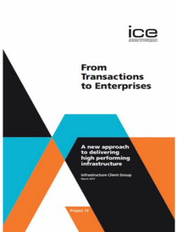
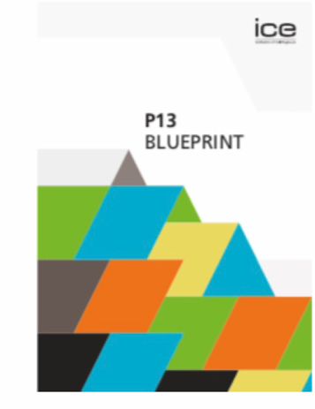
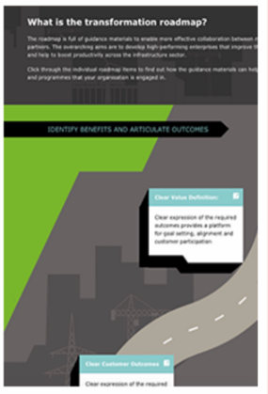
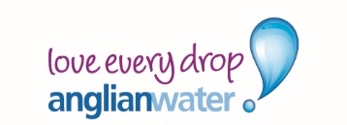
Progress ….
P13 Report 2016
Launch 2018
Early Adopters 2018 - 2019
Structure for implementation phase
Notes:
The key challenge ahead? Trust.
The market will need to:
trust the procurement process, as there may be an element of “forced marriage” when establishing the Enterprise.
recognise that full access to the incentive pot will be largely driven by collective success or failure, some of which may have been out of their control.
be convinced that the Owner is committed to value-based contracting.

Slide 12
Questions?

